Slide 1
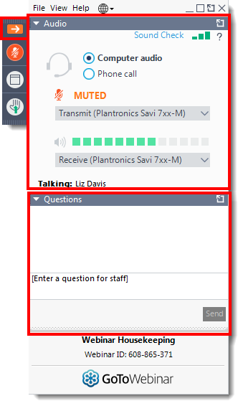
GoToWebinar Housekeeping: Attendee Participation
Your Participation
To the right of your screen is the GoToWebinar control panel.
Open and close your control panel by clicking the arrow.
Note: The control panel will collapse automatically when not in use – click on the arrow to open at any time.
All Attendees will be ‘muted’ during the presentation.

Slide 2
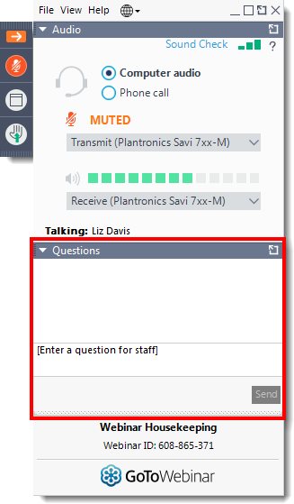
GoToWebinar Housekeeping: Questions
Questions
Please submit your text questions and comments using the Questions panel at any time.
We will be monitoring questions throughout the meeting, and will either reply in the question area, raise your question during Any Other Business, or in some cases, respond afterwards.
Example questions

Slide 3
GoToWebinar Housekeeping: Questions
Questions
Hand Raising function
Ahead of a vote, the Presenter will ask members to use ‘Hand Raising’ to ask a question – simply click on the Hand Raising Button!
We will unmute you so you can ask your question
Hand Raising

Slide 4
GoToWebinar Housekeeping: Voting
Voting
Voting will be live in the meeting with instant results.
The vote options will be on screen - simply select your preference!
Live vote
We will now hold a test vote, to give everyone the opportunity to practise!

Slide 5
8. Election of Officers
Ahead of the vote, are there any questions?
Please use the Hand Raising function
Live vote

